Slide 1
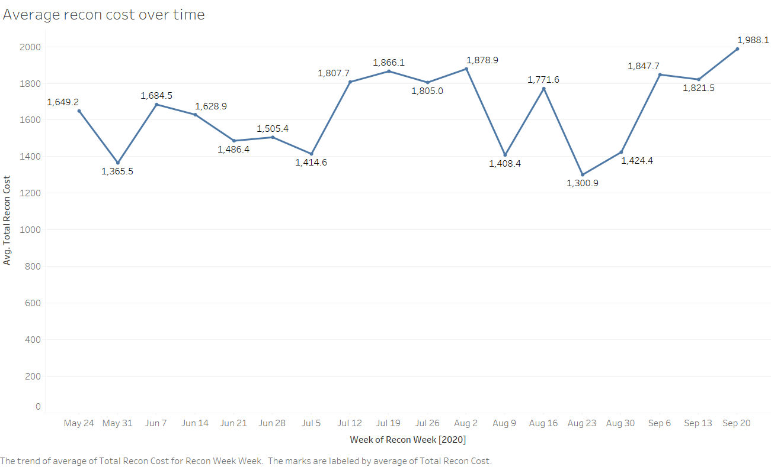
Carvana Case Study
Description
Data consists details of reconditioned vehicles for a span of 18 weeks at a specific Carvana inspection center. It entails vehicle demographics, reconfiguration costs and dates per vehicle.
Profiling
Granularity of vehicle detail per vehicle per week.
All the vehicle IDs shared are non repetitive(i.e, no duplicates)
Few outliers in terms of cost spent on each reconfiguration per make.
Preparation
Minimal pre-processing.
Few attributes needed type conversions in DFs and SQL tables.
Validation
Count Validation
Count match excel and SQL
Type Validation
Type against data values
Visualization
Boxplots, correlation curves and tableau dashboards

Slide 2
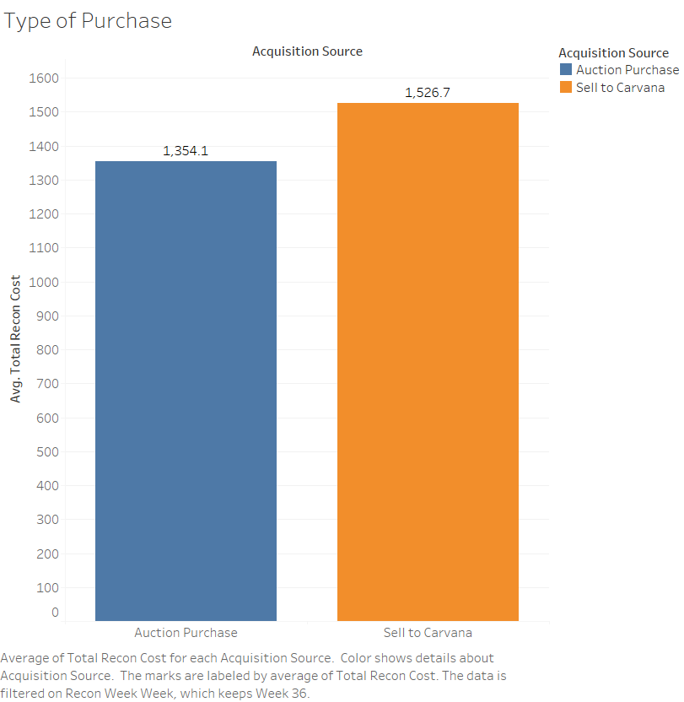
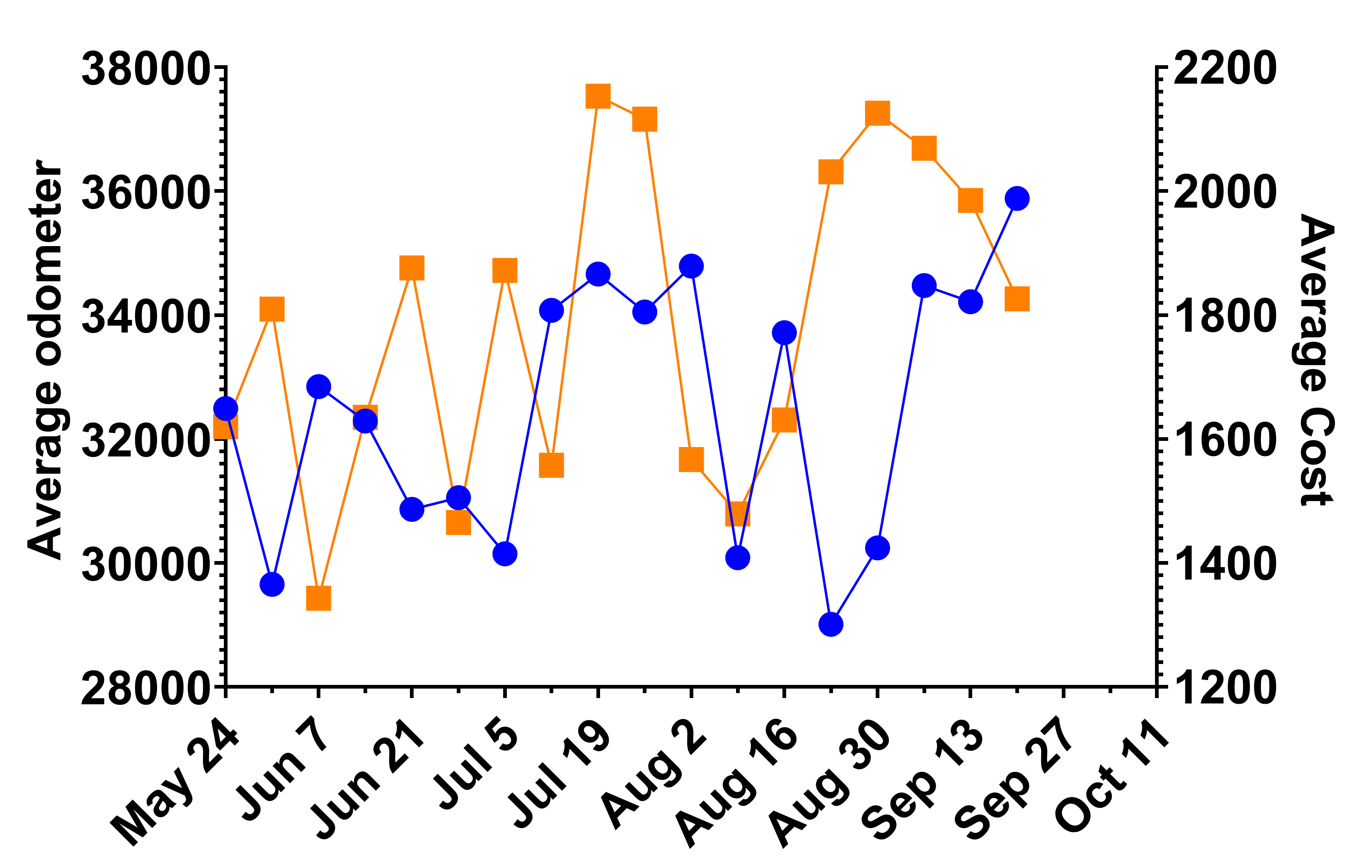
Analysis
Problem Statement Determine possible factors for increase in average cost to recondition a car over time.
Usual Suspects
Odometer range
Type of Purchase

Slide 3
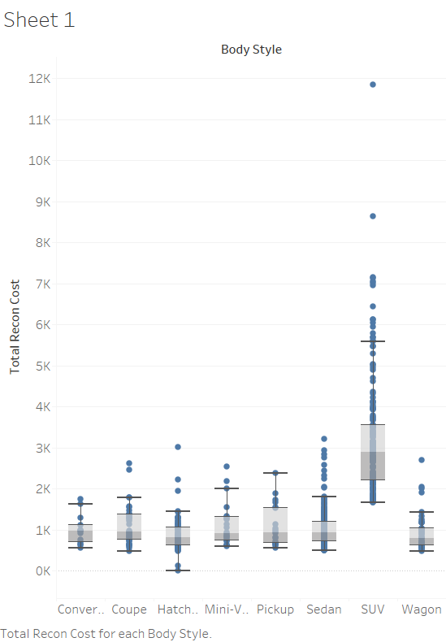
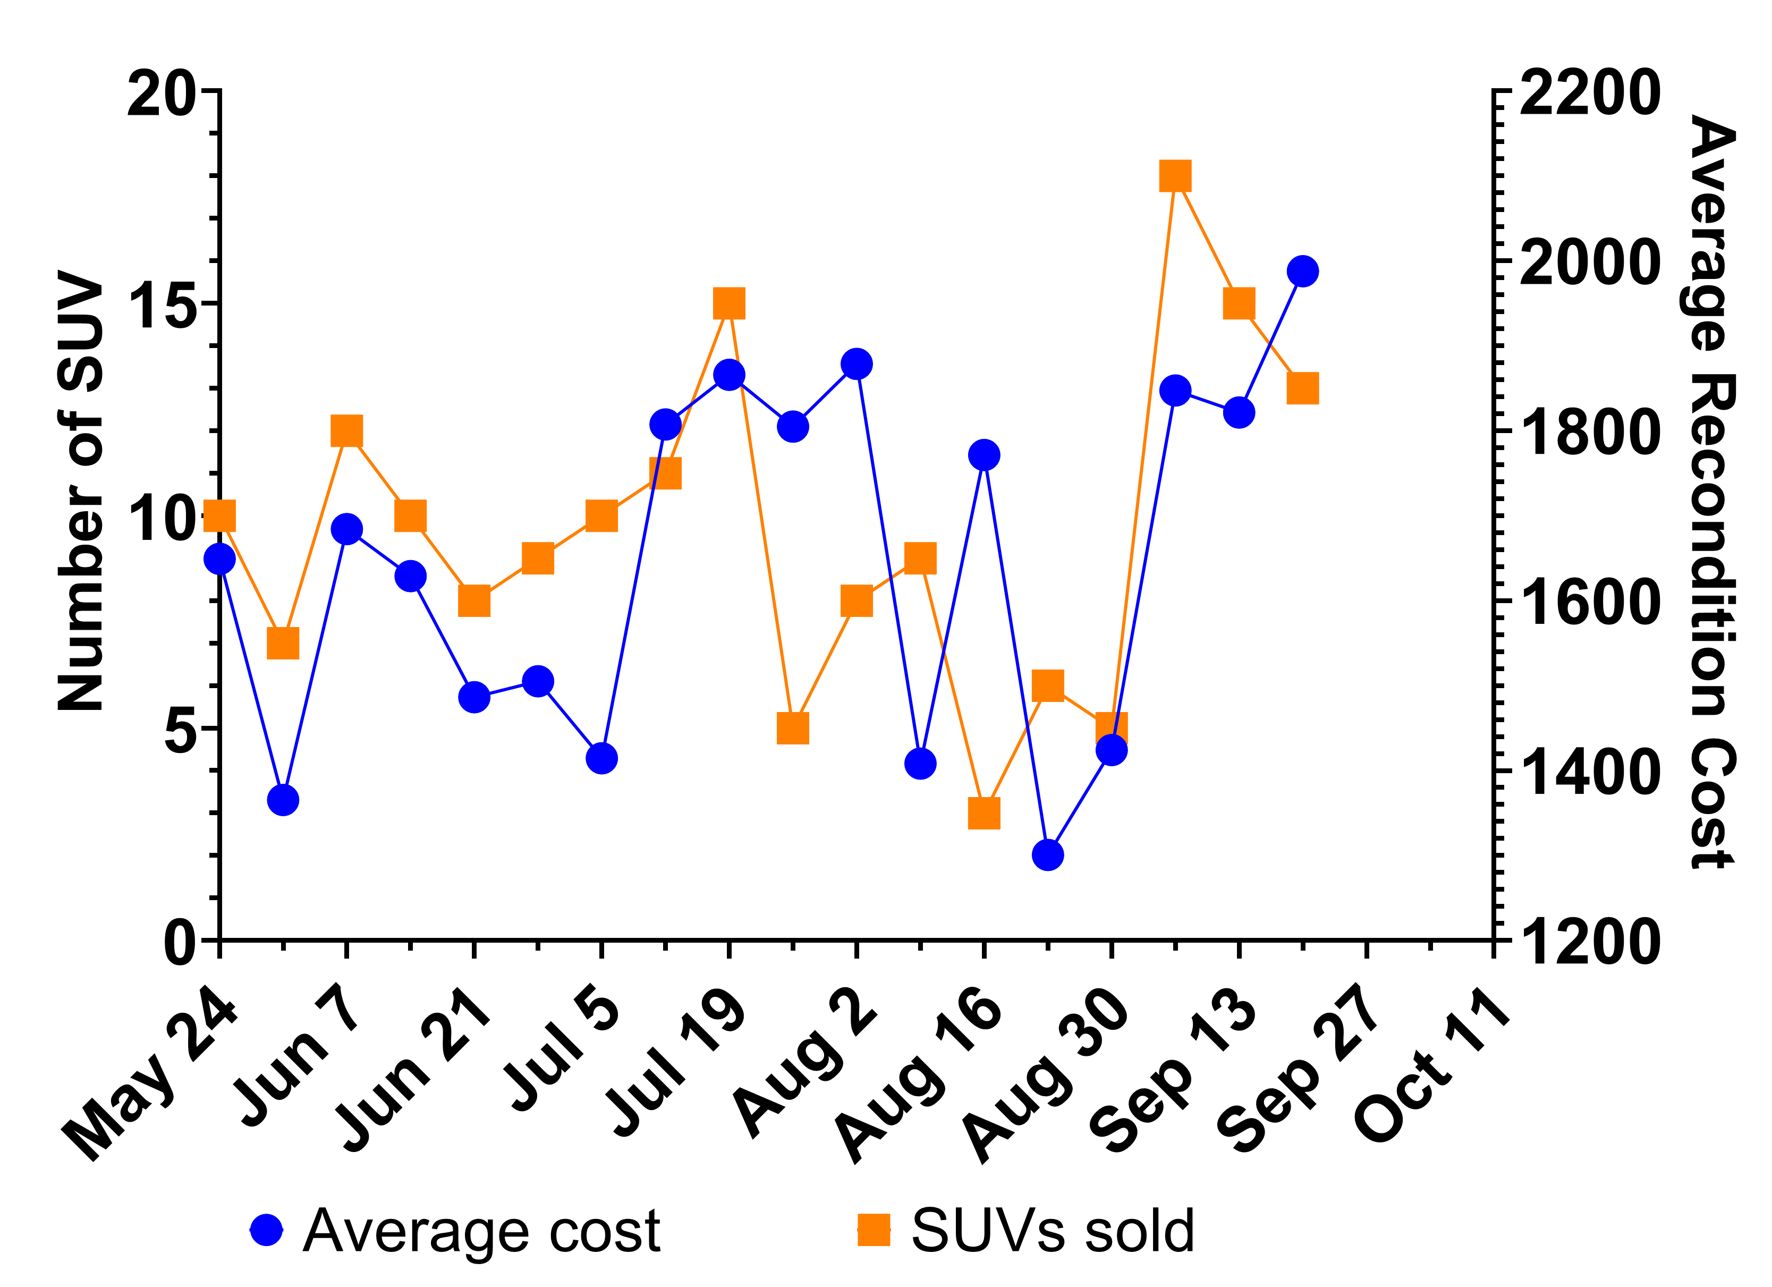
3. Impact of Body Style on Avg Cost
Median recon cost of the SUVs is 3 times higher than other body styles

Slide 4
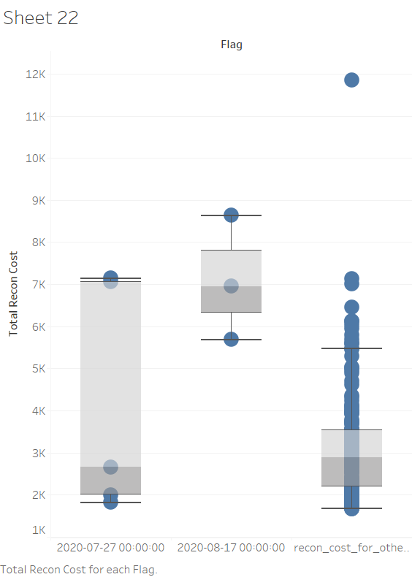
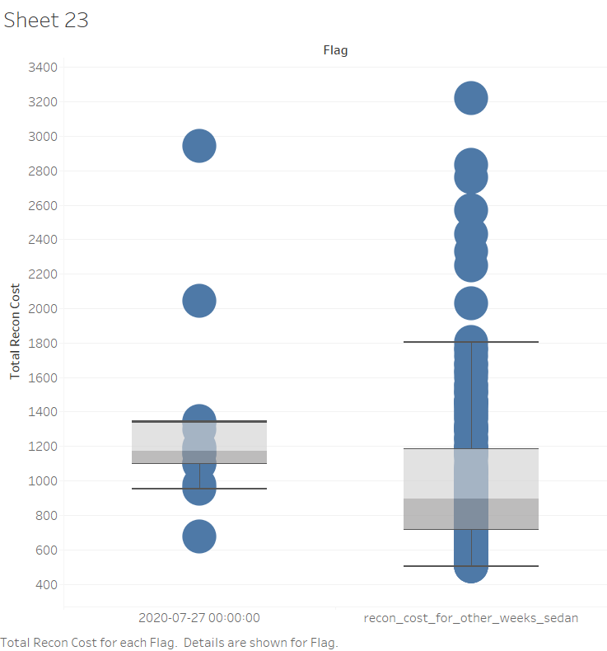
Closer Look
Raise in median prices of sedans for week 7/27 against median of all other weeks
8/17 – Raise in median of SUV reconditioning cost vs reduced sales

Slide 5
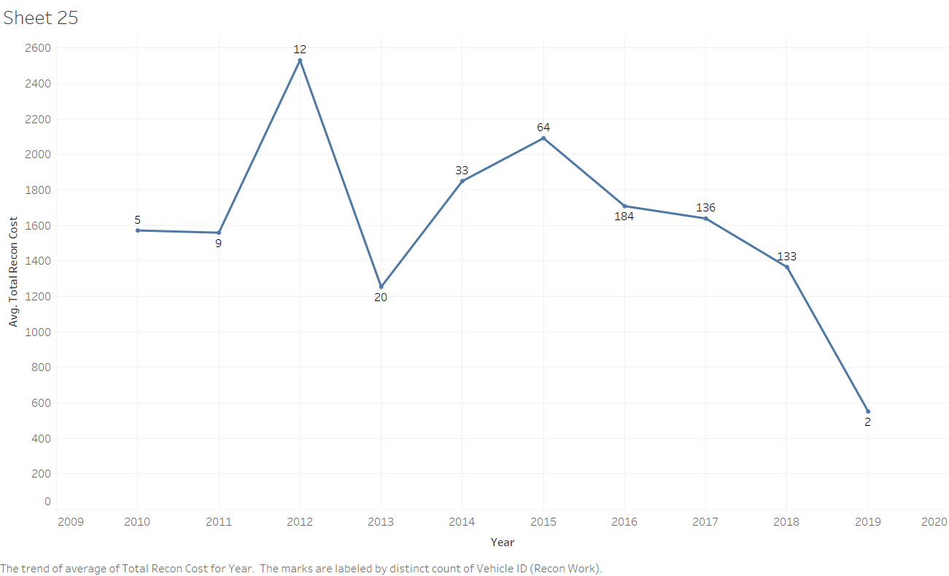
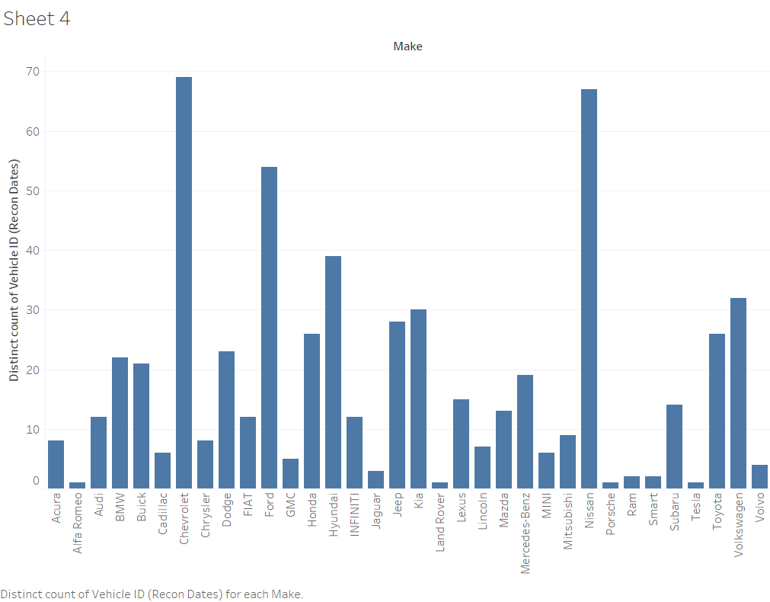
Few other observations
Recon cost per make year and number of vehicles involved
Number of sales per make

Slide 6
Future Scope
Suggestions
Body Type and specifically SUVs seem to be one of the most driving factors for changes in average price over time
Considering median cost to reconfigure a vehicle, it could be more profitable in opting lesser cost makes such as Volkswagen and Chevy compared to higher cost Lincoln Jeep and Infinity
Increasing the number of Sedans might help the business as their average cost of reconditioning seem to be usually constant.
More metrics can help build correlations
Predictive analytics and constructing hypothesis testing
More sample size for few makes to analyze further
Resale prices help gauzing profits and losses
Tools and Languages used
Python
Sql
Tableau
Excel
Jupyter Notebook
Sqlite3

Slide 7
Questions and thoughts!
Thank you

